Slide 1
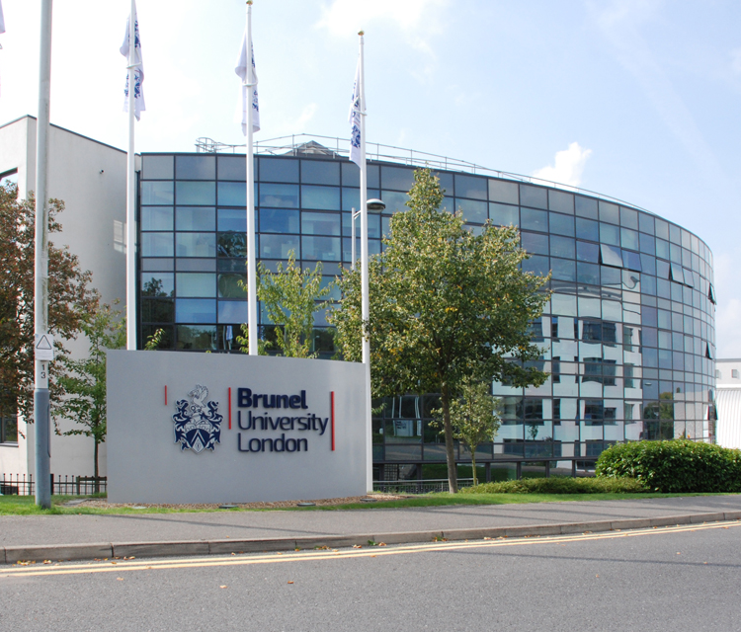
CS1812 Professional Reflection Presentation
B- 38
Presentation Preparation

Slide 2
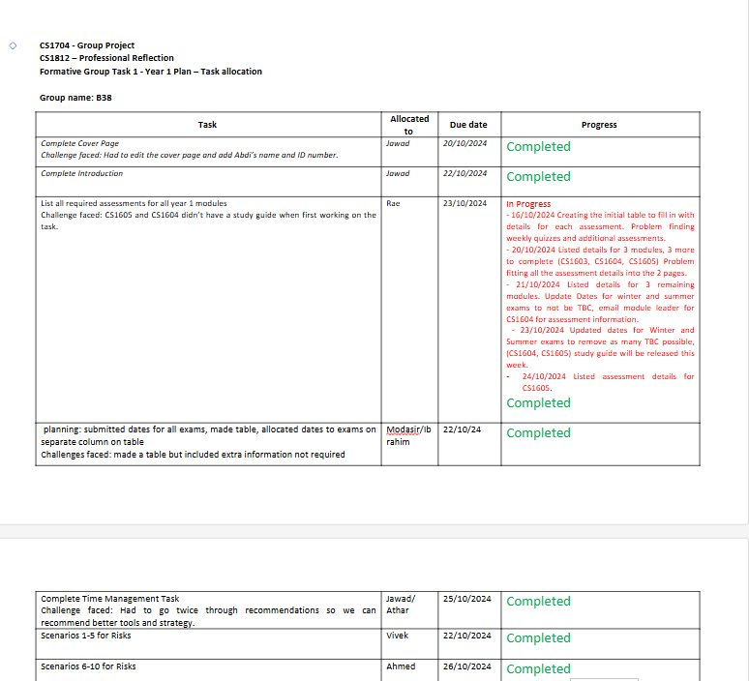
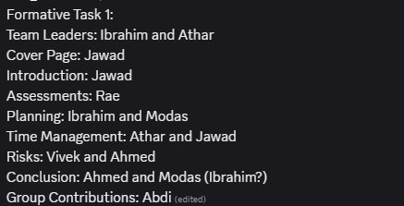
Question I – Leadership Initiative
Athar Hussain 2456634
Task Led: Formative task 1
Delegation Strategy:
Formal meeting with roles allocated​
Allowed open discussion for team members to discuss strengths​
Gave autonomy to team members to be involved in which task would best suit them​
Tools:
Task allocation sheet ​
Monitored individual progress providing platform to observe which team member may need more help ​
- Thereby providing more support to team members who required it
Success Rate:
100% completion thanks to each team member working on tasks that aligned most with their strengths ​
Factored in team members preferences on what they wanted to do boosting morale and overall outcomes ​
​ Key lesson
communication opens doors of information that can be used to optimise the group and increase likelihood of success

Slide 3
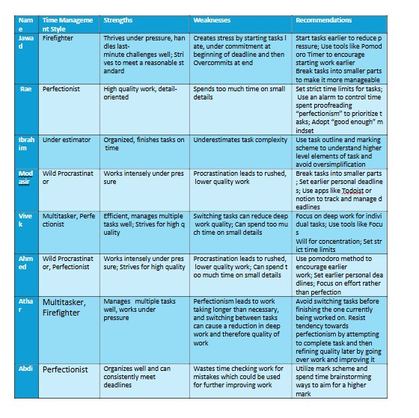
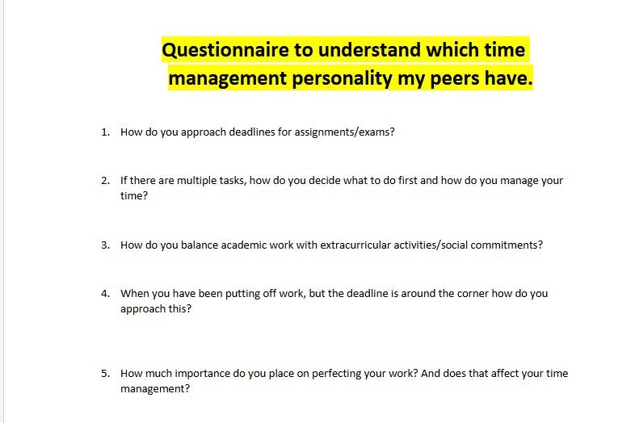
Question II – Leadership Challenges
Athar Hussain 2456634
Challenge
Dual role Dilemma ​
Differing views on how time management questionnaire answers should be recorded
Balancing being a team member and a team leader when engaging in discussion ​
Knowing when to step back and when to assert leadership ​
Solution ​
Encouraged open dialogue and active listened from a place of team leader to allow for effective information gathering ​
With this information decided as a team leader that objectively the best thing for the group was to combine the differing views together to come to a solution that both parties would be alright with
Outcome ​
Led to creative solution to recording questionnaire answers ​
Future improvements
Future improvements
- When conflict arises remember that you are team leader and seek to come to a resolution that suits both parties

Slide 4
Question III – Personal Growth
Athar Hussain 2456634
Evolution of my leadership style
Leadership style
Based around open communication and seeing problems form different perspectives e.g. my team members
Strength
Promoting freedom within team to voice their ideas/concerns/call for assistance/ celebrate their success
Area to improve
Time management and organisation was a point of tension at times with internal deadlines specifically causing some problems
In the future using organisation tools like notion to monitor my responsibilities as team leader

Slide 5
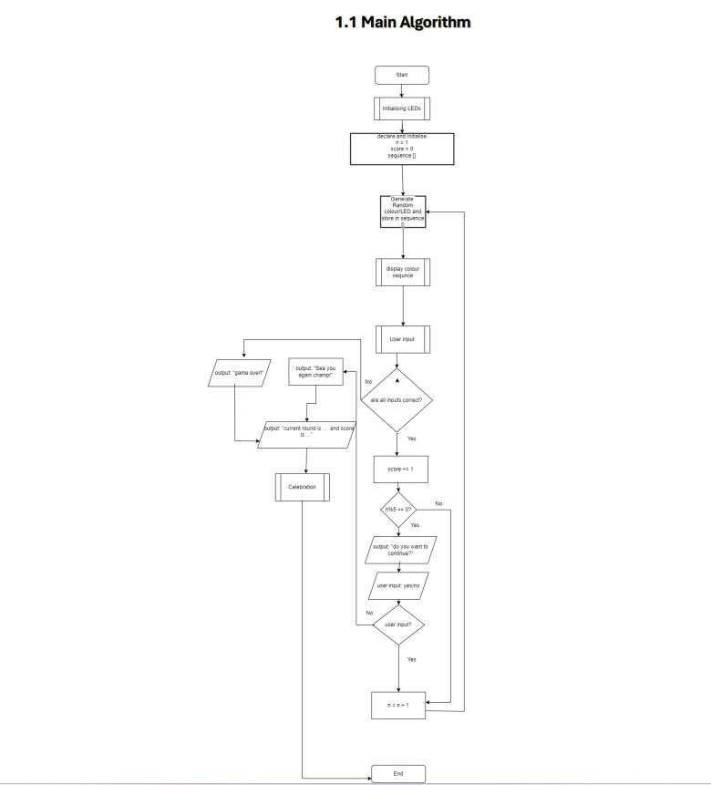
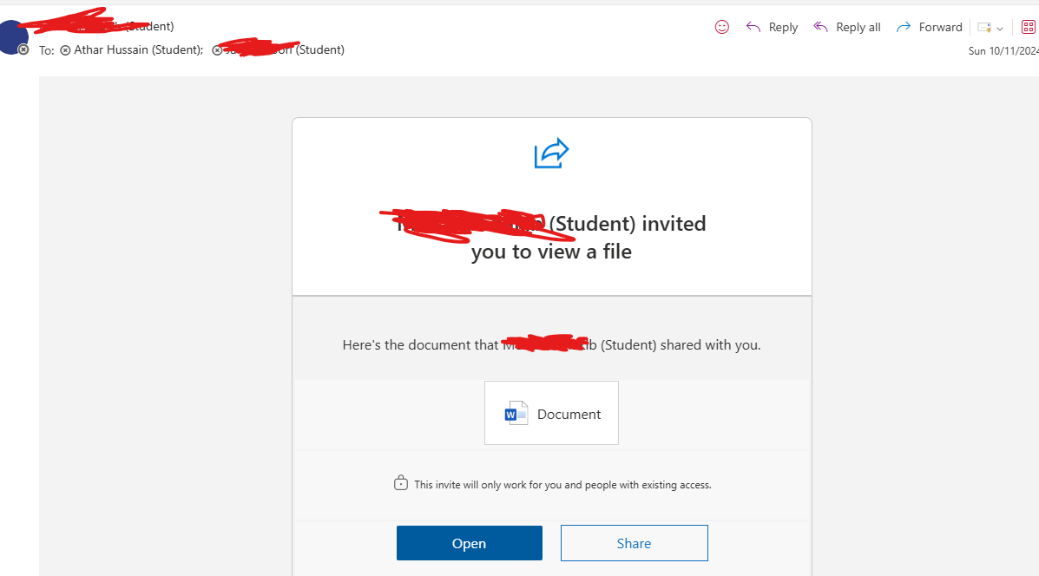
Question IV – Teamwork Contributions
Athar Hussain 2456634
Contributions
- Worked on creating a complex algorithm with multiple flow charts for the simon says program for formative task 2 with another team member
Challenge
Merging independently developed parts into a final product
Skills gained
Problem solving when working collaboratively on a task - Utilising progress update meetings as a platform to engage with each other and provide advice on and support to further our own individual progress on the individual flow charts we had done so far
Taking the initiative – Actively seeking to arrange regular progress updates so that we could reap the above-mentioned benefits as much as possible

Slide 6
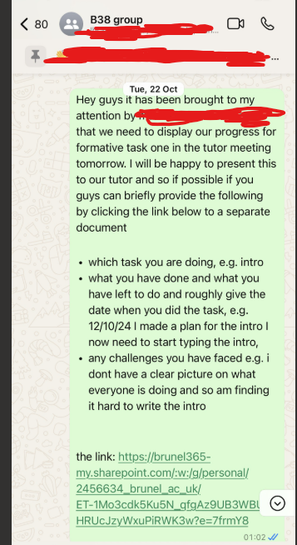
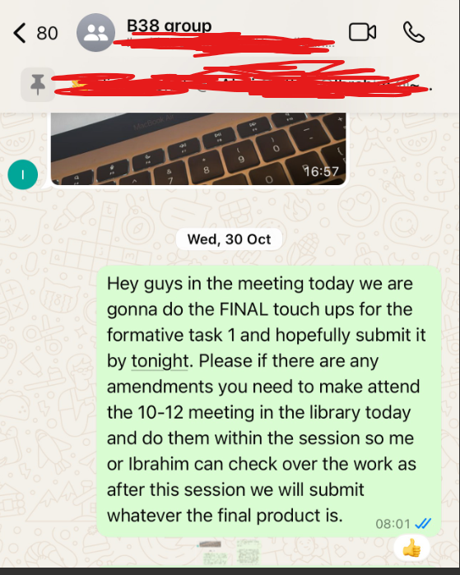
Evidence Gallery
Athar Hussain 2456634
Proof of excellence

Slide 7

Thank You!
B - 38

